Slide 1
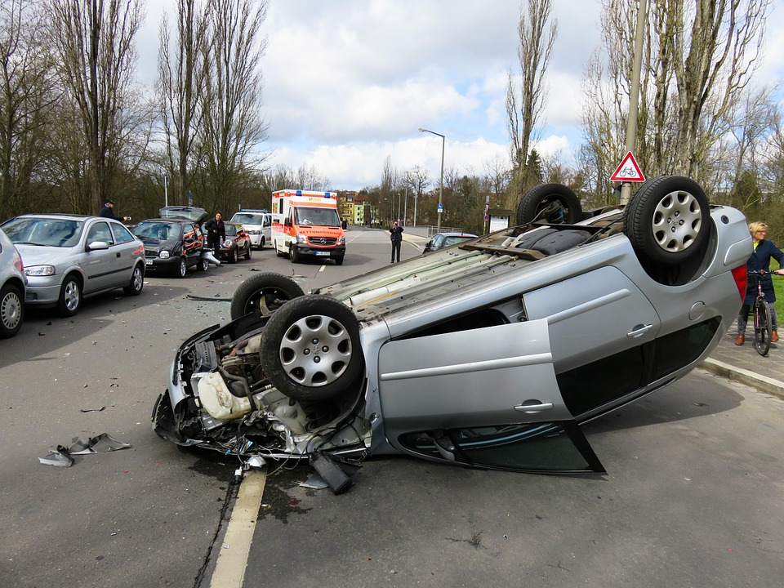
CS455 Accident Detection
By Lalith Aditya Chunduri

Slide 2

Model and Application Functionality
Deep learning-based accident detection system
Uses MobileNetV2 with Conv2D and Dense layers
Classifies video frames as 'Accident' or 'Non Accident'
Evaluated using accuracy graphs and confusion matrix
Simulated emergency alert triggered based on prediction confidence

Slide 3
Things I Learned from the Project
Loading image datasets efficiently using TensorFlow
Transfer learning and freezing pretrained MobileNetV2
Interpreting model performance with graphs
Generating evaluation visuals (confusion matrix, image predictions)
Designing alert mechanisms using prediction confidence
Applying CNNs to detect real-life events in frames

Slide 4
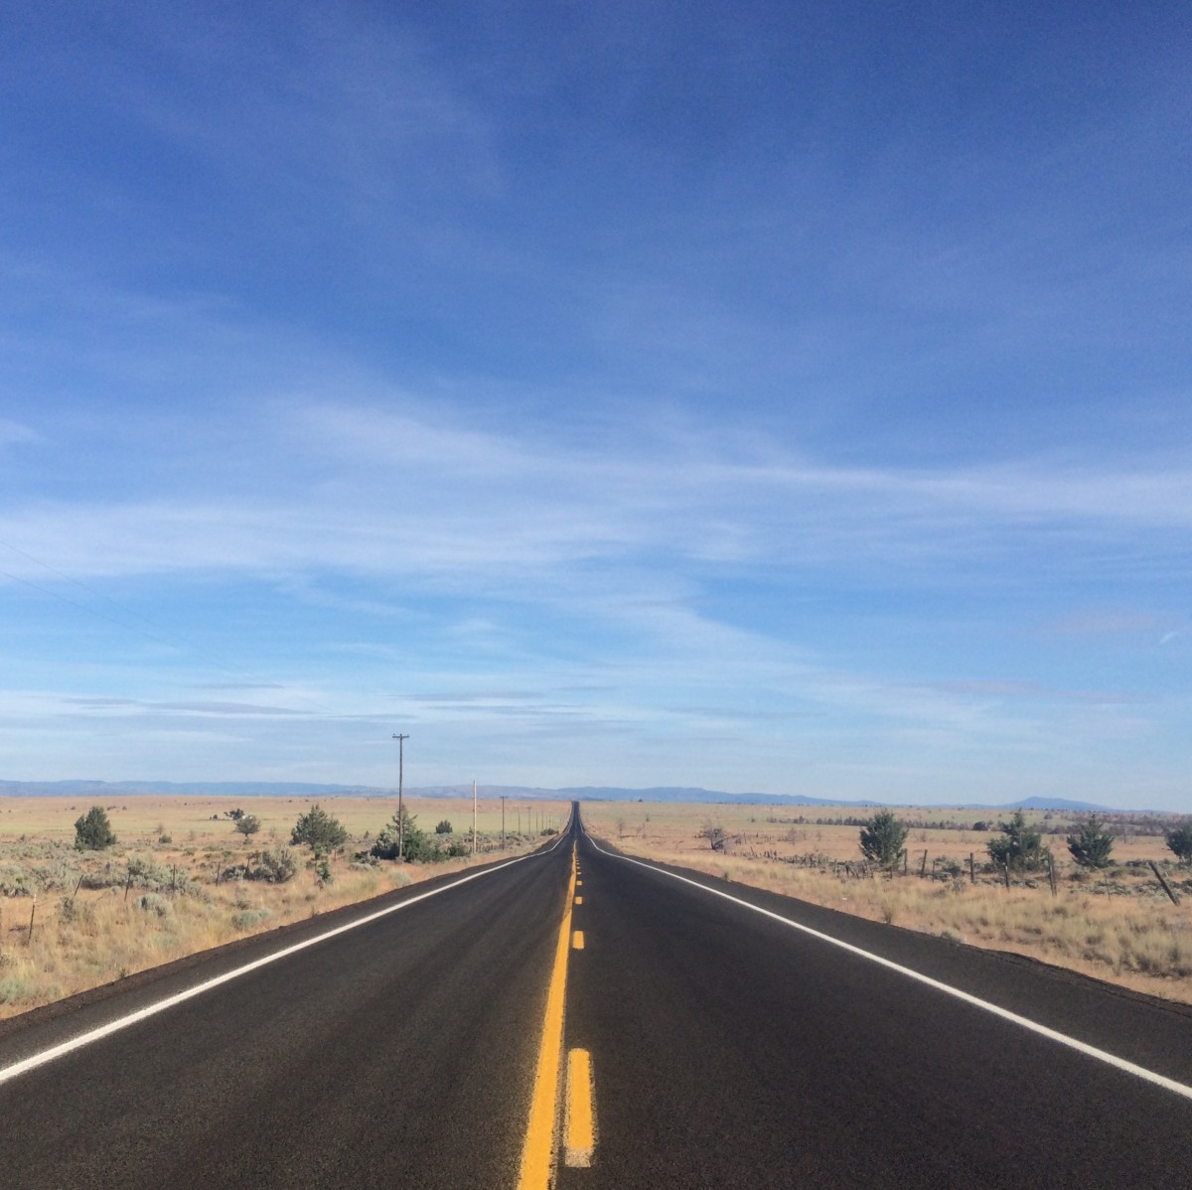
Obstacles and Future Work
⚠️ Challenges:
Handling video-to-frame conversion
Ensuring dataset diversity for model generalization
No object-level detection (e.g., YOLO) in current version
🔮 Future Plans:
Integrate YOLOv5 for real-time vehicle collision detection
Improve detection under low-light or foggy conditions
Deploy on devices like Raspberry Pi for real-world use
Include GPS & timestamp data in alert system

